Slide 1

B.Tech 6th Semester Minor project presentation
“Student’s Resource App”
Presented by:
Amruta Sadhu (200305105003)
Ayush Patel (200305105127)
Yaksh Panchal (200305105130)
Supervisors:
Kapil Dev Raghuwanshi
Kalpesh Kundanani
PARUL INSTITUTE OF TECHNOLOGY, PARUL UNIVERSITY
NAME OF THE INSTITUTE, PARUL UNIVERSITY

Slide 2
Content of Presentation
Abstract
Introduction
Problem Statement
Proposed Methodology
Project Module
Use case diagram/ER diagram/Flow diagram
Hardware and software Requirement
Excepted Outcome of the Project
Limitation
Conclusion and Future Work
References
NAME OF THE INSTITUTE, PARUL UNIVERSITY
NAME OF THE INSTITUTE, PARUL UNIVERSITY

Slide 3
1.Abstract
Nowadays There are many platforms related to learning but finding the best resource is still difficult, so this app has been created to solve this problem.
The main aim of research for this topic is not merely to gather information. Instead, it goes beyond that. The true goal of research is to seek answers to previously unanswered questions to contribute to the body of knowledge in a discipline.
Everyone have their own platform to share their notes , questions , knowledge and many more to help other students.
NAME OF THE INSTITUTE, PARUL UNIVERSITY
NAME OF THE INSTITUTE, PARUL UNIVERSITY

Slide 4
2.Introduction
A student-based application that works on shared materials is a powerful tool for facilitating collaboration and communication among students and educators.
One of the key features of these applications is the ability to ask questions and receive answers from a community of students and teachers. Students can post their questions and receive responses from other students or teachers who are experts in the relevant subject area. This allows students to get help quickly and efficiently, even outside of class hours.
Student-based application that works on solving student doubts is a valuable tool for helping students succeed academically. By providing a platform for students to ask questions, access pre-existing answers, and access resources that can help them better understand course material, these applications can help students achieve better grades, improve their understanding of challenging concepts, and become more confident learners
NAME OF THE INSTITUTE, PARUL UNIVERSITY
NAME OF THE INSTITUTE, PARUL UNIVERSITY

Slide 5
Overall, a student-based application that allows students to create and view posts is a powerful tool for promoting collaboration, communication, and engagement among students. By providing a platform for students to share their ideas and interact with their peers, these applications can help students develop a sense of community, build relationships, and enhance their learning experience.
Technology to be used:
Programming Language: Dart.
Development Environment: Android studio or Visual Studio code.
Database: Firebase database, Fire store.
APIs: Firebase storage API
NAME OF THE INSTITUTE, PARUL UNIVERSITY
NAME OF THE INSTITUTE, PARUL UNIVERSITY

Slide 6
3.Problem Statement
Many students struggle to stay organized and keep track of their assignments, deadlines, and course materials, leading to missed deadlines, incomplete assignments, and poor grades. Students may feel overwhelmed by the amount of information and resources available to them online, making it difficult to identify high-quality sources, understand complex concepts, and stay focused on the most important information.
Instructors may struggle to provide individualized support and feedback to students, particularly in large classes, leading to a lack of engagement, motivation, and personalization in the learning experience.
Students not prefer to ask their questions to everyone. They find right people for ask a particular questions.
NAME OF THE INSTITUTE, PARUL UNIVERSITY
NAME OF THE INSTITUTE, PARUL UNIVERSITY

Slide 7
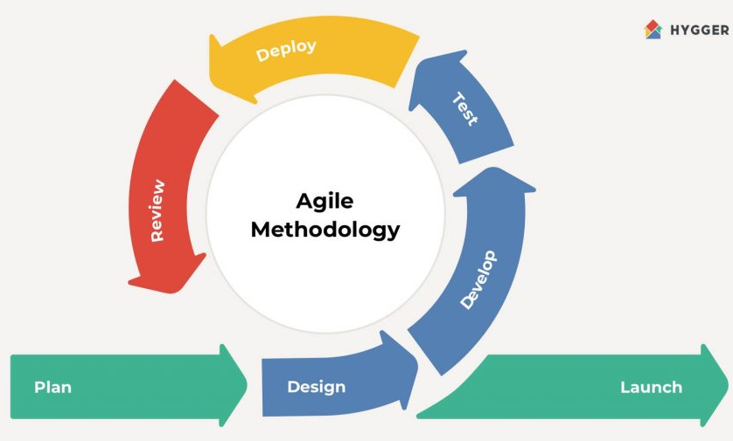
4.Proposed Methodology
Agile Methodology:
Define requirements: This defining the scope of the application, and identifying the features and functionalities that the application will offer.
Design UI/UX: The next step is to design the user interface and user experience of the application. This includes creating wireframes, designing the user interface, and defining the user flow.
Develop the backend: Once the UI/UX design is complete, the next step is to develop the backend of the application. This includes setting up a database, creating APIs, and developing server-side code.
Develop the frontend: After the backend is complete, the next step is to develop the frontend of the application using Flutter. This includes implementing the UI design, integrating APIs, and developing client-side code.
NAME OF THE INSTITUTE, PARUL UNIVERSITY
NAME OF THE INSTITUTE, PARUL UNIVERSITY

Slide 8
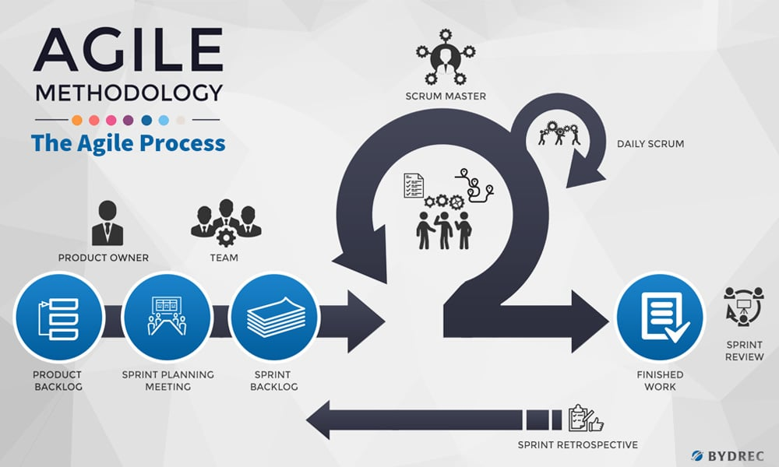
Testing: Once the frontend and backend are complete, the next step is to test the application thoroughly to ensure that it is bug-free, user-friendly, and meets all the requirements.
Deployment: After testing, the application can be deployed to the respective app stores for users to download and use.
Maintenance: Once the application is deployed, it is important to maintain it by fixing bugs, adding new features, and updating it regularly to ensure that it remains relevant and up-to-date.
NAME OF THE INSTITUTE, PARUL UNIVERSITY
NAME OF THE INSTITUTE, PARUL UNIVERSITY

Slide 9
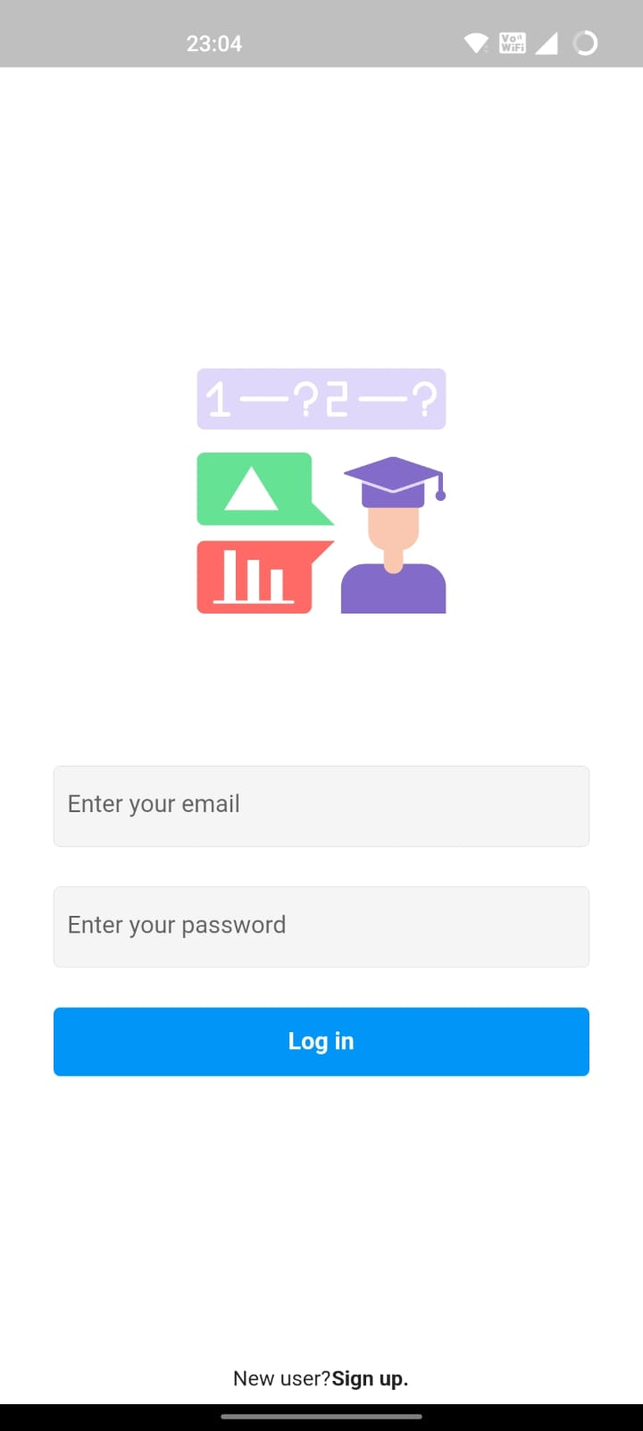
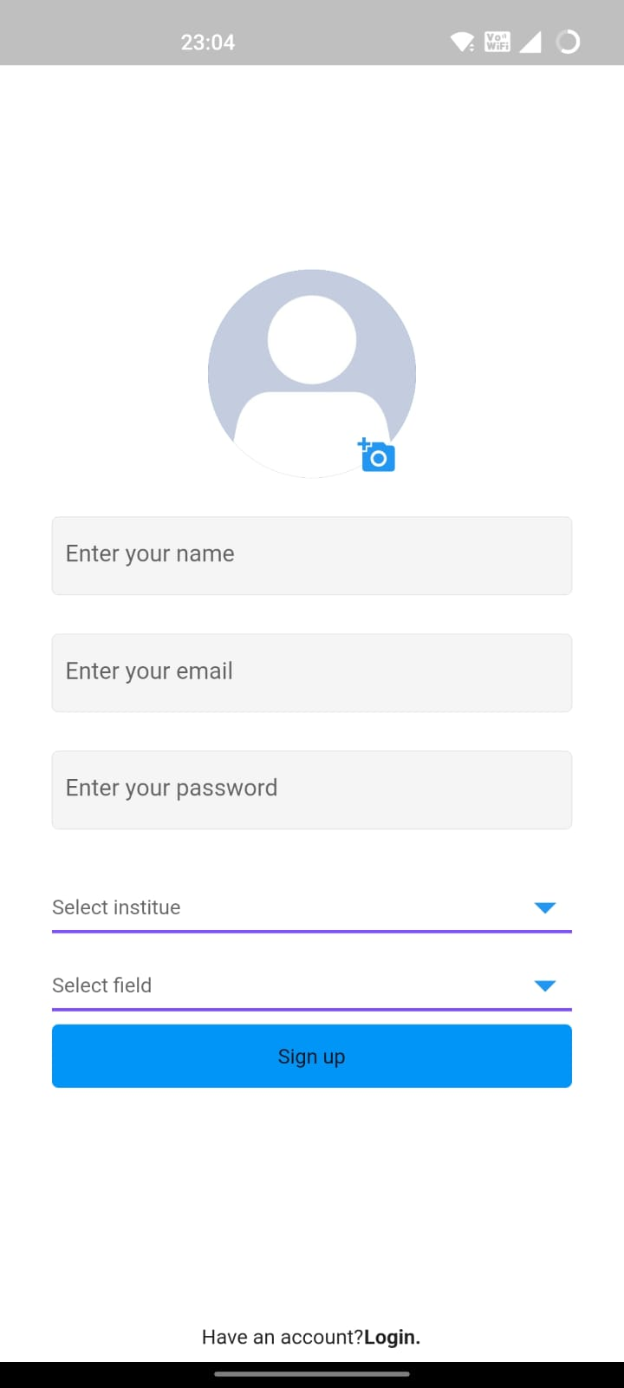
5.Project Module
Authentication Module
Firebase Authentication Setup
Sign In Screen
Sign Up Screen
NAME OF THE INSTITUTE, PARUL UNIVERSITY
NAME OF THE INSTITUTE, PARUL UNIVERSITY

Slide 10
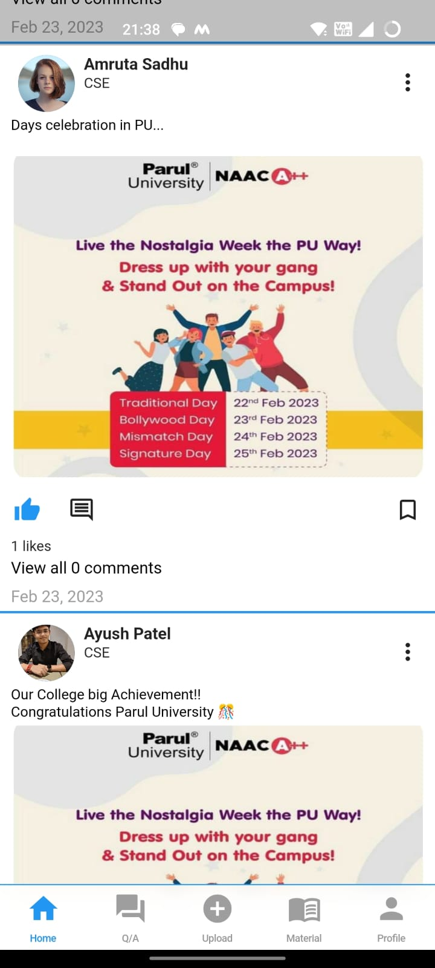
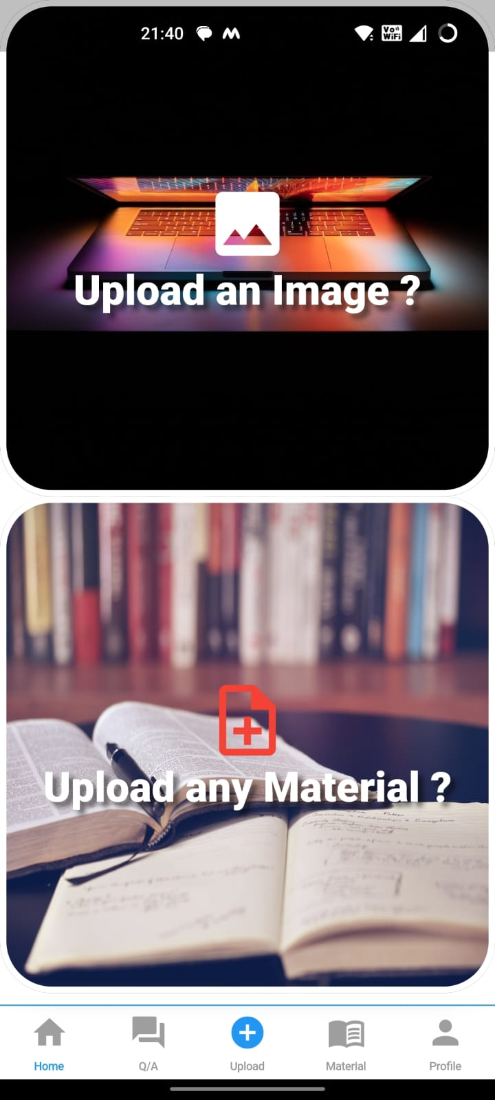
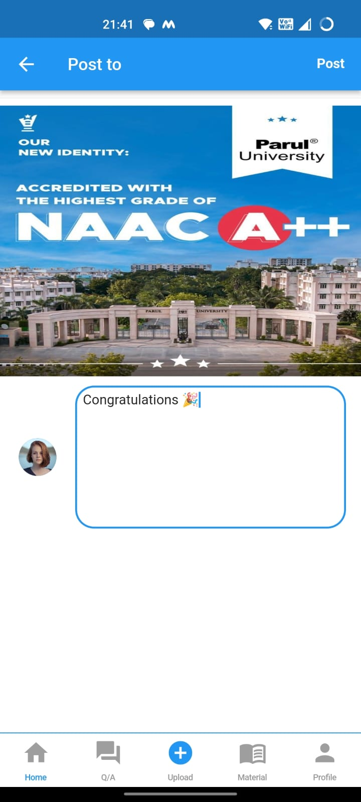
Post Module
Create a Post
Post Feed
Like and Comment on Posts
NAME OF THE INSTITUTE, PARUL UNIVERSITY
NAME OF THE INSTITUTE, PARUL UNIVERSITY

Slide 11
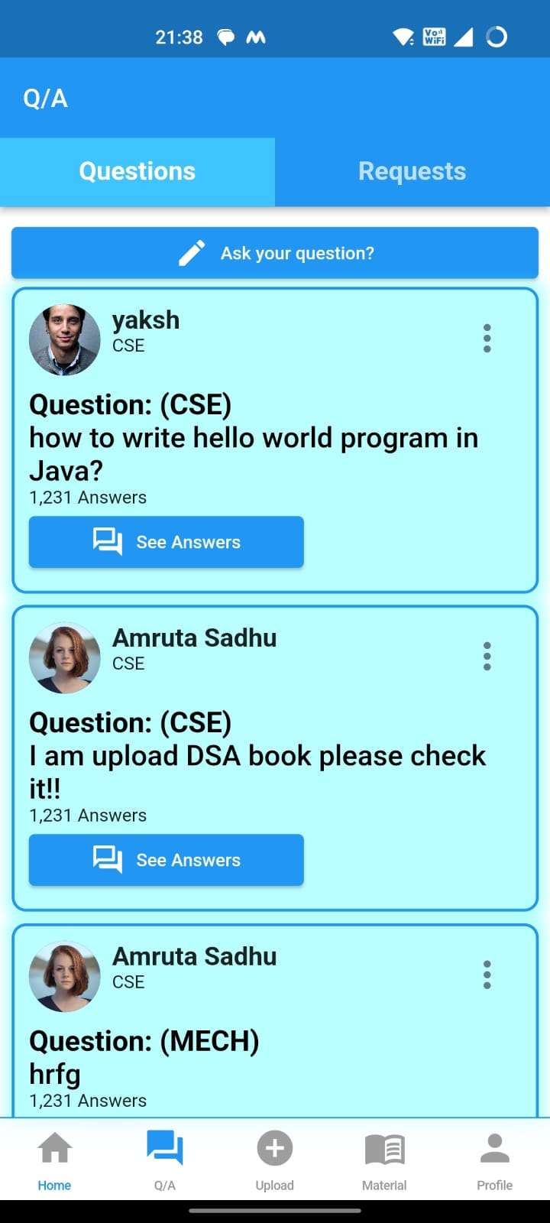
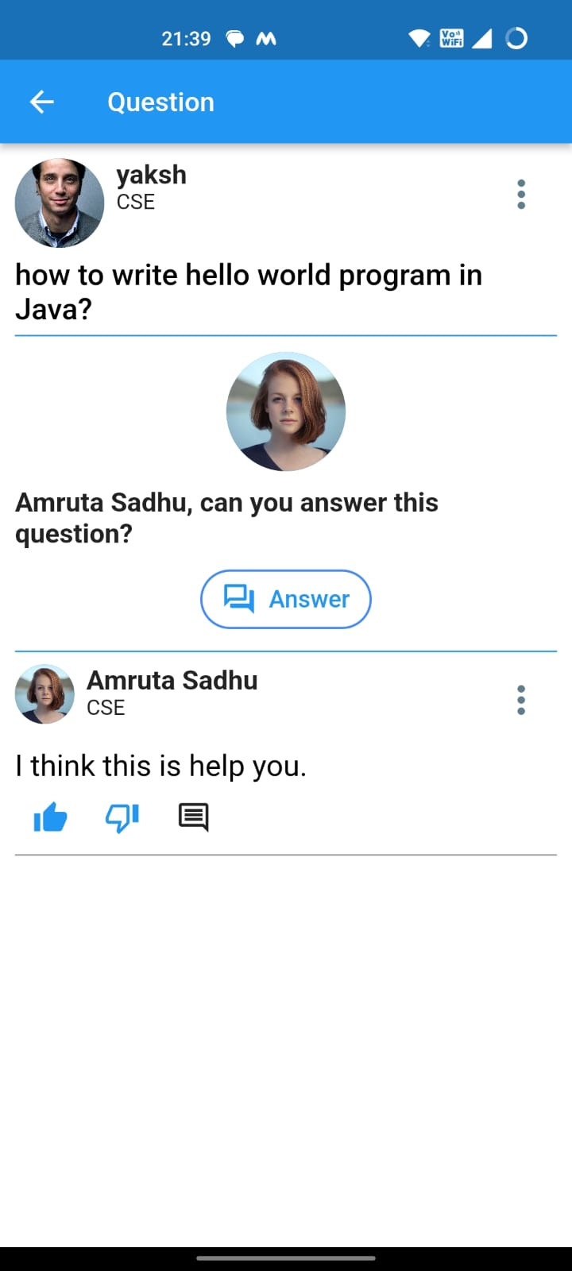
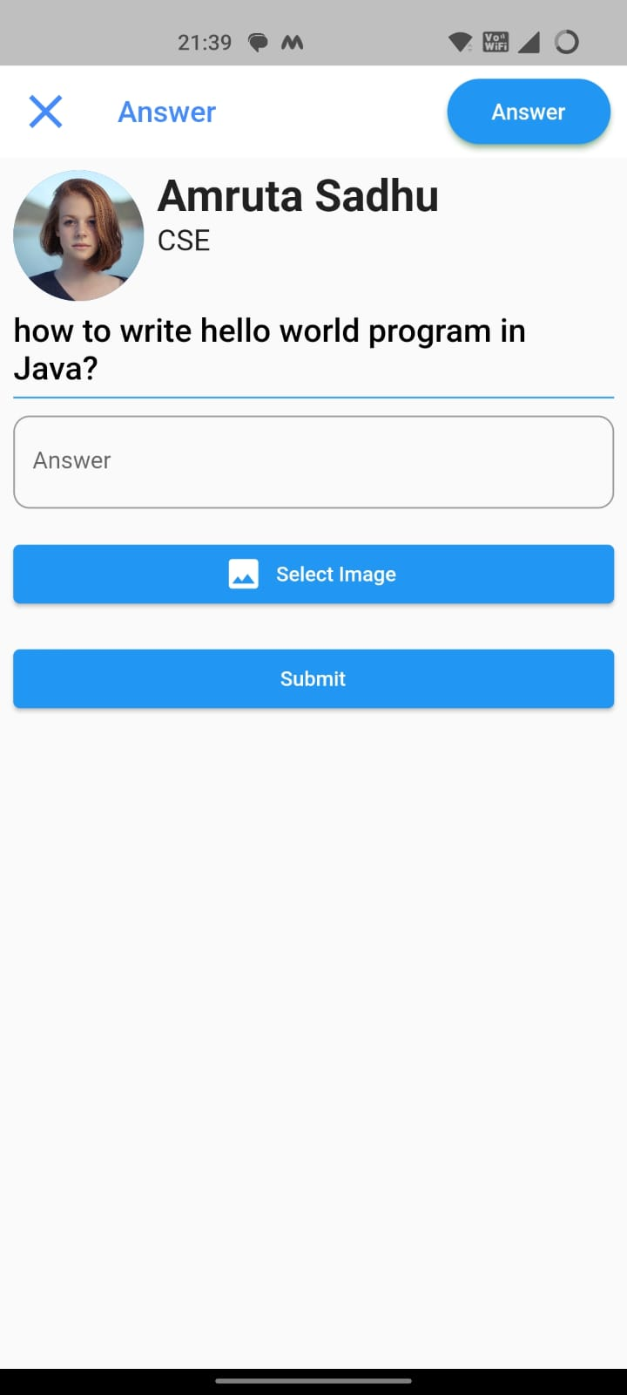
Q&A Module
Question Feed
Ask a Question
Answer a Question
Comment on a Question or Answer
Search for Questions
User Profiles.
NAME OF THE INSTITUTE, PARUL UNIVERSITY
NAME OF THE INSTITUTE, PARUL UNIVERSITY

Slide 12
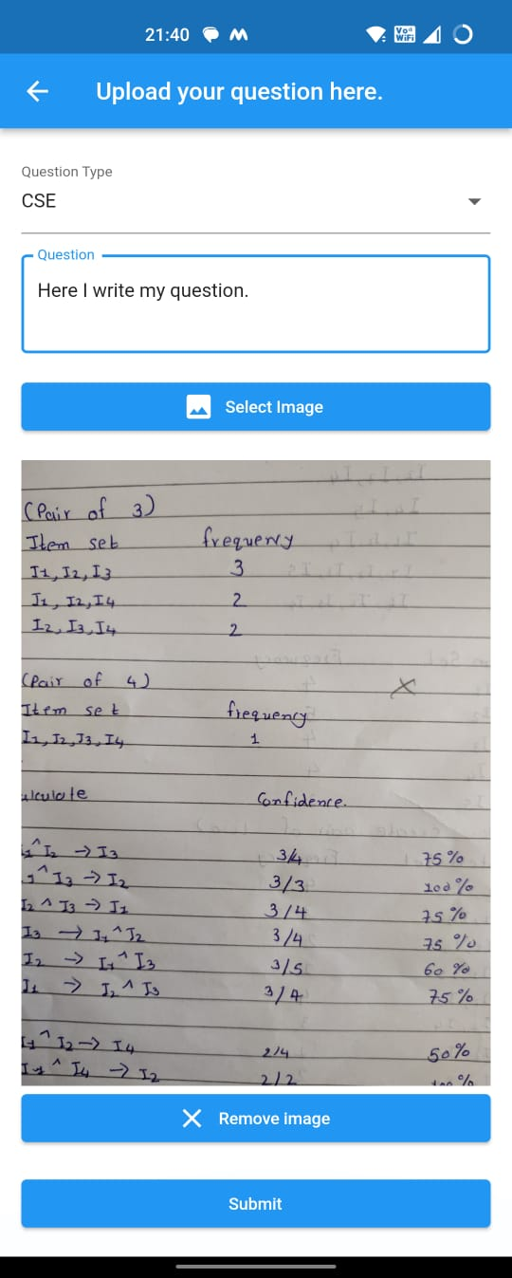
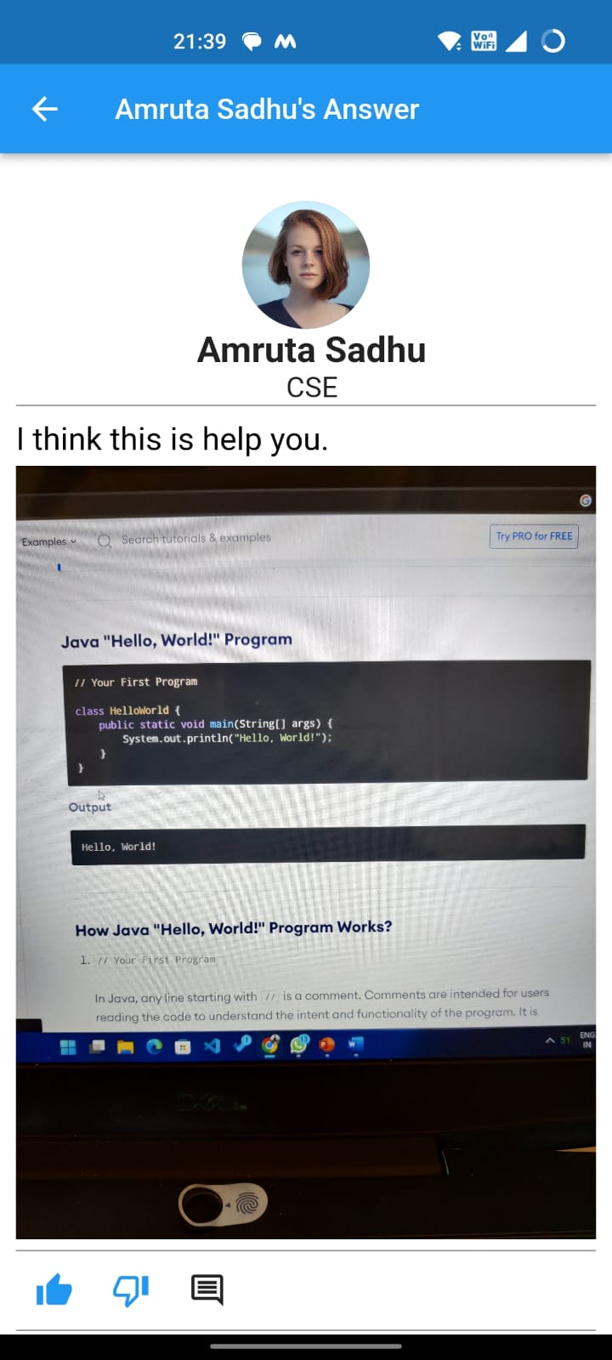
Upload Question
See full answer
NAME OF THE INSTITUTE, PARUL UNIVERSITY
NAME OF THE INSTITUTE, PARUL UNIVERSITY

Slide 13
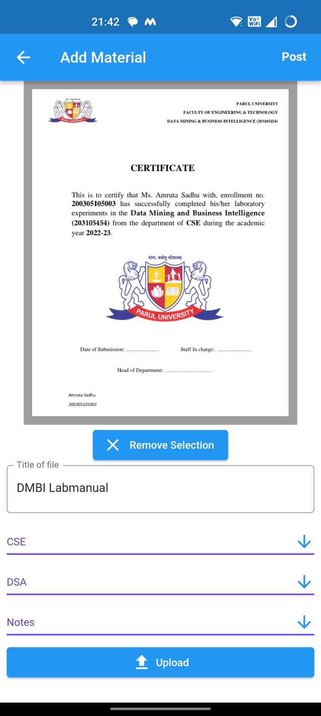
Material Design Module
Upload Material
Fields screen
Subject Screen
Books Screen
Notes Screen
Assignment Screen
NAME OF THE INSTITUTE, PARUL UNIVERSITY
NAME OF THE INSTITUTE, PARUL UNIVERSITY

Slide 14
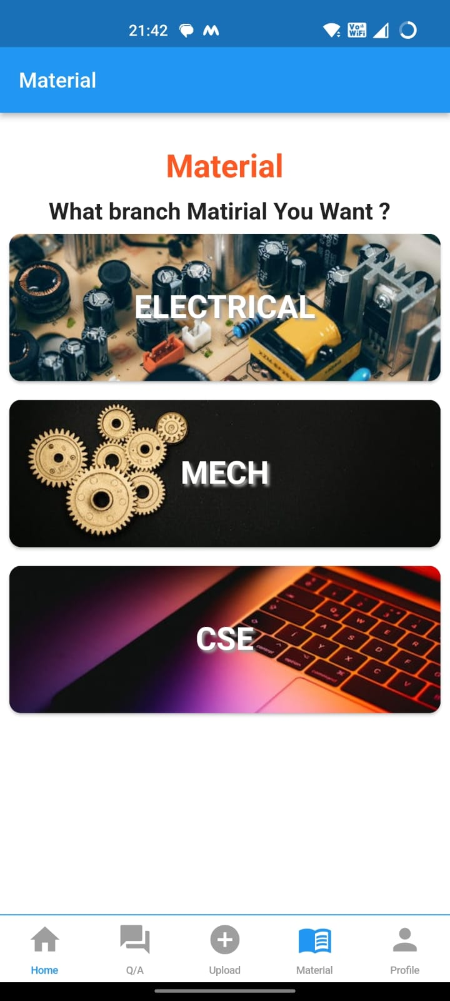
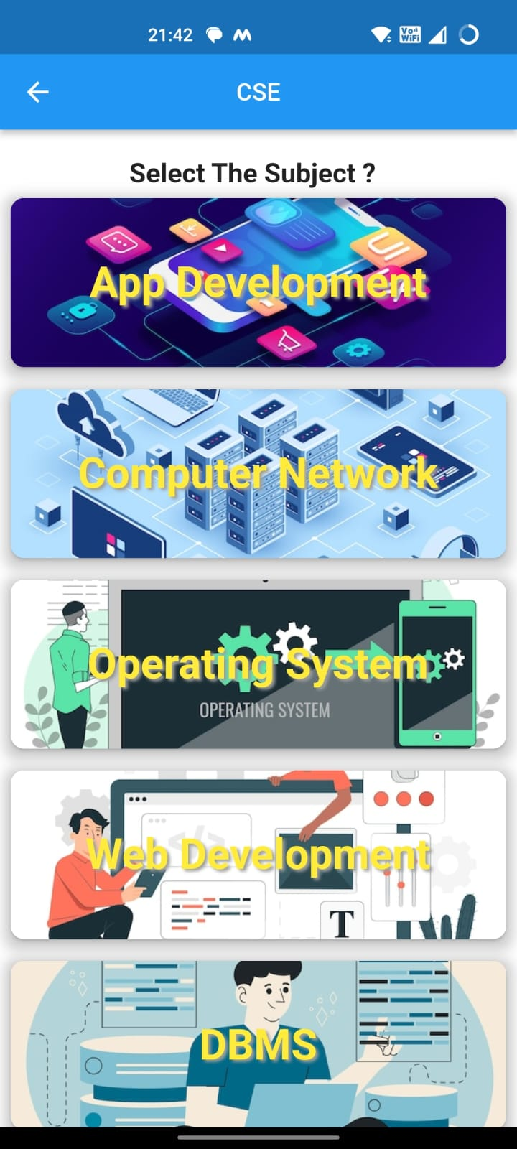
Fields are shown.
Subjects are shown.
NAME OF THE INSTITUTE, PARUL UNIVERSITY
NAME OF THE INSTITUTE, PARUL UNIVERSITY

Slide 15
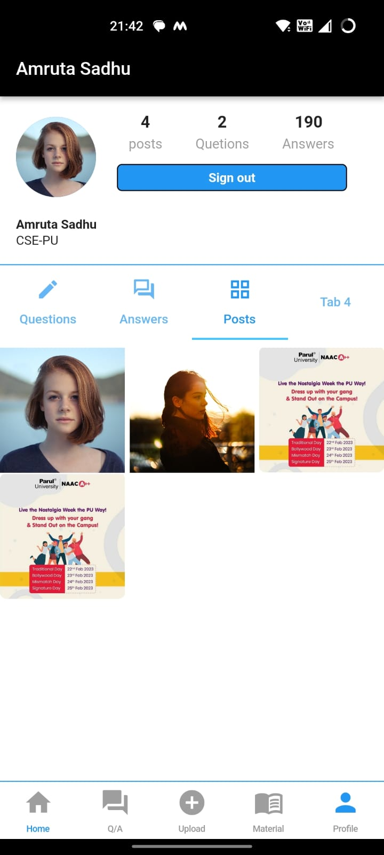
Profile Module
User Information
Education Information
Questions Asked
Answers Given
Settings
Logout
NAME OF THE INSTITUTE, PARUL UNIVERSITY
NAME OF THE INSTITUTE, PARUL UNIVERSITY

Slide 16
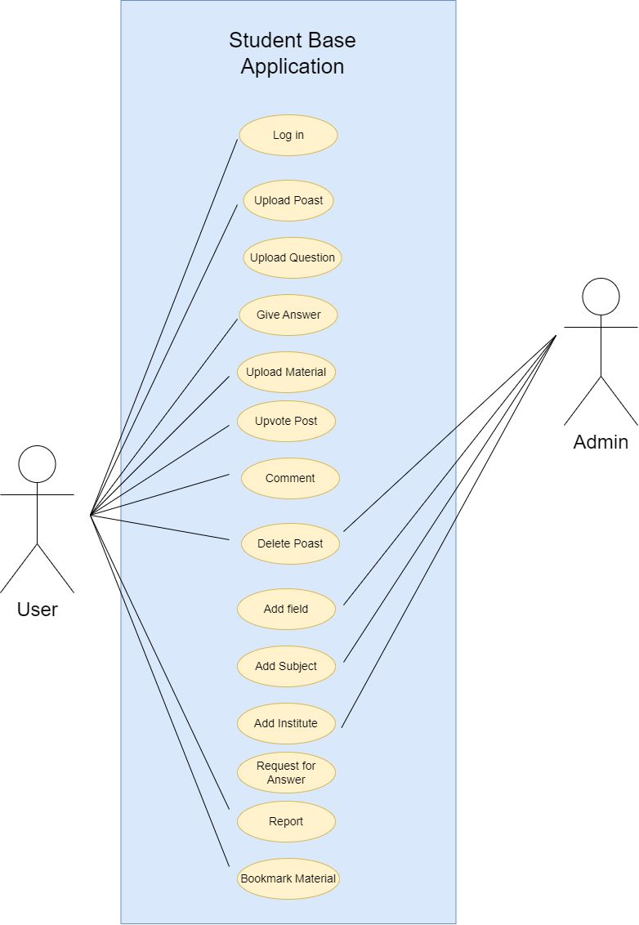
6. Diagrams
Use case Diagram:
NAME OF THE INSTITUTE, PARUL UNIVERSITY
NAME OF THE INSTITUTE, PARUL UNIVERSITY

Slide 17
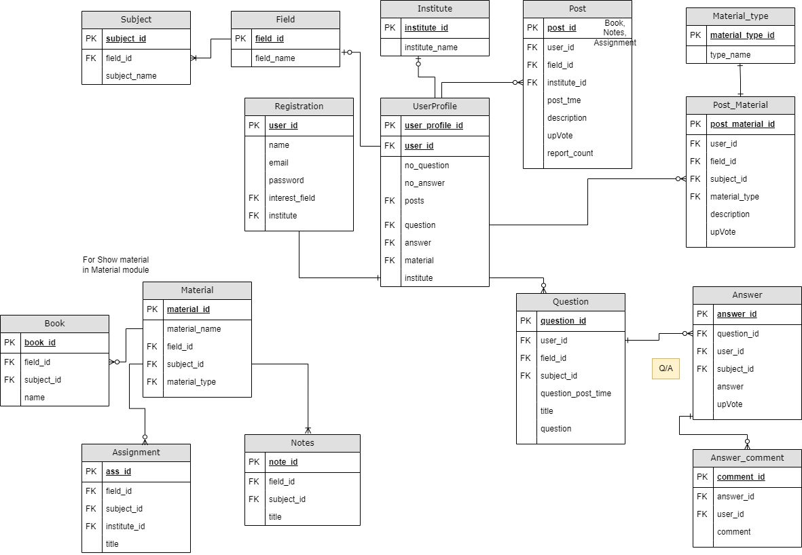
6. Diagrams
ER Diagram
NAME OF THE INSTITUTE, PARUL UNIVERSITY
NAME OF THE INSTITUTE, PARUL UNIVERSITY

Slide 18
7.Requirements
Software Requirements
Android Studio
Flutter SDK
Dart Programming Language
Firebase
PDF Viewer plugin (For viewing PDF file)
Image Picker plugin (for selecting image from gallery or camera)
Hardware Requirements
Windows, Mac, or Linux operation system
At least 4GB RAM
Intel i5 processor or equivalent
Android or iOS device for testing (optional)
Hard Disk.
SSD minimum 256 gb.
Mobile device.
NAME OF THE INSTITUTE, PARUL UNIVERSITY
NAME OF THE INSTITUTE, PARUL UNIVERSITY

Slide 19
8.Expected Outcome of the Project
The expected outcome of the project is to create a well-functioning Flutter app .
That can be used by students from various fields to upload and view materials, ask and answer questions, and access various features related to their academic needs.
The app should be user-friendly and efficient, with a responsive design that allows users to easily navigate through the different modules and access the information they need.
The Home page should display all the latest posts and updates, while the Upload module should allow users to upload images and PDF files, which are displayed in different modules.
The Q/A module should allow users to ask and answer questions, while the Material module should display all materials in a well-organized and easy-to-navigate format.
Overall, the expected outcome is to create an app that helps students learn and succeed in their studies.
NAME OF THE INSTITUTE, PARUL UNIVERSITY
NAME OF THE INSTITUTE, PARUL UNIVERSITY

Slide 20
9.Limitation
Limited content: The app may have limited content as it depends on the user's upload. If not many users are contributing, the app may not be very useful for users.
Quality of content: The quality of content uploaded by users may vary, and there may be inaccurate or incomplete information available.
User engagement: Getting users to engage with the app may be a challenge. If users do not find the app useful, they may not use it regularly, and the app may not be sustainable in the long run.
Technical limitations: The app may face technical limitations such as limited storage space, bandwidth, or processing power.
NAME OF THE INSTITUTE, PARUL UNIVERSITY
NAME OF THE INSTITUTE, PARUL UNIVERSITY

Slide 21
10.Conclusion and Future Work
Conclusion:
The flutter app developed is designed to provide a platform for students to access study materials, upload and share educational resources, and get help with their academic queries.
The app consists mainly four modules, including a home page, upload module, Q/A module, and material module. The home page displays all the posts uploaded by users, while the upload module allows users to upload images and PDF files.
The Q/A module enables users to ask questions and get answers from other students, and the material module is dedicated to providing well-formatted subject-wise study materials.
NAME OF THE INSTITUTE, PARUL UNIVERSITY
NAME OF THE INSTITUTE, PARUL UNIVERSITY

Slide 22
Future Work:
In the future, the app can be further enhanced by adding features such as user profiles, social sharing, and gamification to increase engagement among users.
Additionally, integrating AI-powered tools for intelligent content recommendations and personalized learning paths can enhance the app's utility and effectiveness.
Further, the app can be expanded to include features that cater to different learning styles and preferences, such as audio and video content, quizzes, and interactive simulations. Overall, the flutter app has the potential to revolutionize the way students learn and collaborate in the digital age.
NAME OF THE INSTITUTE, PARUL UNIVERSITY
NAME OF THE INSTITUTE, PARUL UNIVERSITY

Slide 23
11.References
Free Code Camp, 2022. You tube. [Online] Available at: https://www.youtube.com/watch?v=mEPm9w5QlJM&t=17982s [Accessed 15 02 2020].
2. Flutter documentation. 2020. [Online] Available at: https://flutter.dev/docs [Accessed 20 02 2020].
3. firebase, 2020. Firebase Documentation. [Online] Available at: https://firebase.google.com/docs/auth/andro id/start [Accessed 03 02 2020]
NAME OF THE INSTITUTE, PARUL UNIVERSITY
NAME OF THE INSTITUTE, PARUL UNIVERSITY

